Slide 1
Instructor Materials Chapter 8: Network Troubleshooting
CCNA Routing and Switching
Connecting Networks
Notes:
Cisco Networking Academy Program
Connecting Networks
Chapter 8: Network Troubleshooting

Slide 2
Chapter 8 - Sections & Objectives
8.1 Troubleshooting Methodology
Explain troubleshooting approaches for various network problems.
8.2 Troubleshooting Scenarios
Troubleshoot end-to-end connectivity in a small to medium-sized business network, using a systematic approach.
Notes:
2

Slide 3
8.1 Troubleshooting Methodology
Notes:
Cisco Networking Academy Program
Connecting Networks
Chapter 8: Network Troubleshooting

Slide 4
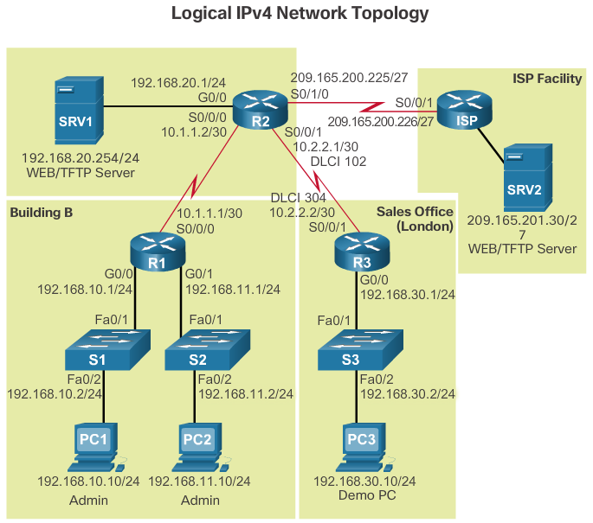
Troubleshooting Methodology Network Documentation
Documentation is critical to being able to monitor and troubleshoot a network.
Documentation includes:
Configuration files, including network configuration files and end-system configuration files
Physical and logical topology diagrams
A baseline performance levels
Notes:
8.1 - Troubleshooting Methodology
8.1.1 – Network Documentation

Slide 5
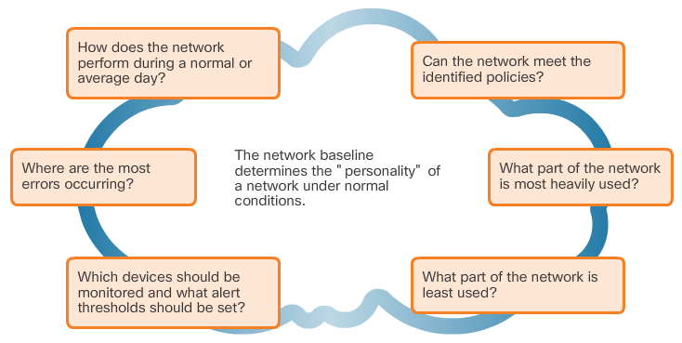
Troubleshooting Methodology Network Documentation
To establish and capture an initial network baseline, perform the following steps:
Step 1. Determine what types of data to collect.
Step 2. Identify devices and ports of interest.
Step 3. Determine the baseline duration.
Notes:
8.1 - Troubleshooting Methodology
8.1.1 – Network Documentation

Slide 6
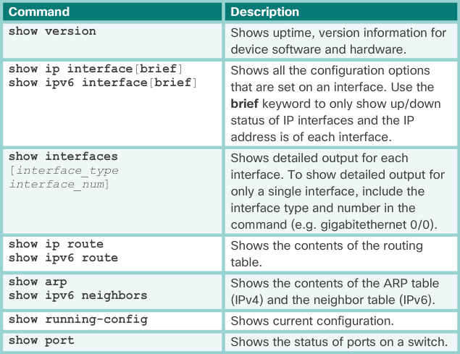
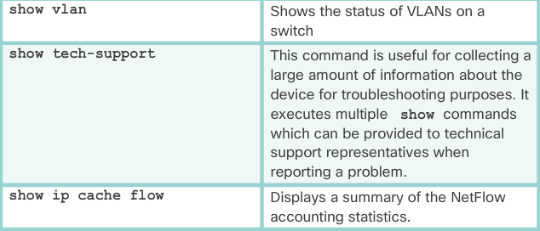
Troubleshooting Methodology Network Documentation
Common Cisco IOS commands used for data collection.
Manual collection of data should be reserved for smaller networks or limited to mission-critical network devices.
Sophisticated network management software is typically used to baseline large and complex networks.
Notes:
8.1 - Troubleshooting Methodology
8.1.1 – Network Documentation

Slide 7
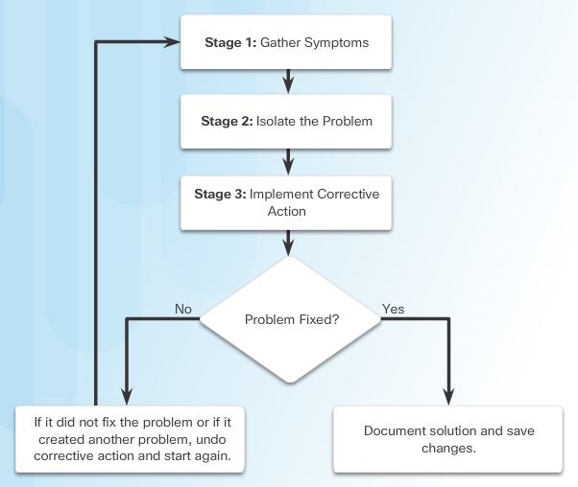
Troubleshooting Methodology Troubleshooting Process
Notes:
8.1 – Troubleshooting Methodology
8.1.2 – Troubleshooting Process

Slide 8
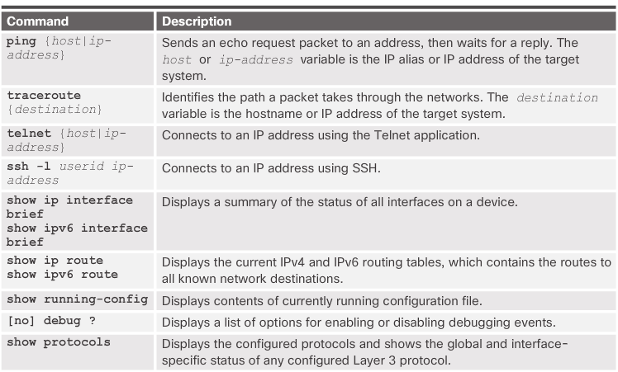
Troubleshooting Methodology Troubleshooting Process
Common Cisco IOS commands used to gather the symptoms of a network problem.
Notes:
8.1 – Troubleshooting Methodology
8.1.2 – Troubleshooting Process

Slide 9
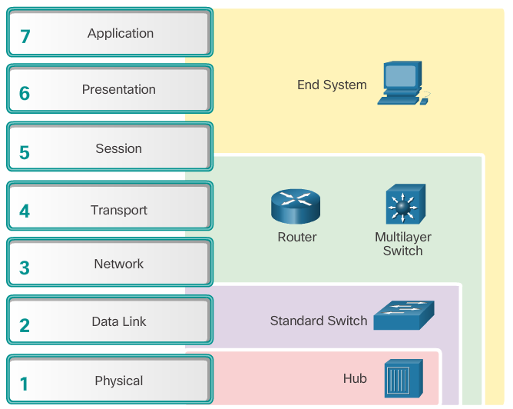
Troubleshooting Methodology Isolating the Issue Using Layered Models
After gathering symptoms, the network administrator compares the characteristics of the problem to the logical layers of the network to isolate and solve the issue.
Notes:
8.1 – Troubleshooting Methodology
8.1.3 – Isolating the Issue Using Layered Models

Slide 10
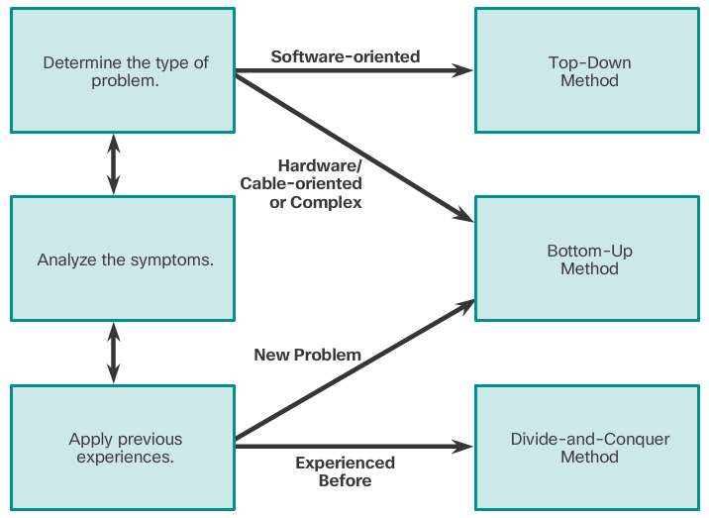
Troubleshooting Methodology Isolating the Issue Using Layered Models
Using the layered models, there are three primary methods for troubleshooting networks:
Bottom-up
Top-down
Divide-and-conquer
Notes:
8.1 – Troubleshooting Methodology
8.1.3 – Isolating the Issue Using Layered Models

Slide 11
8.2 Troubleshooting Scenarios
Notes:
Cisco Networking Academy Program
Connecting Networks
Chapter 8: Network Troubleshooting

Slide 12
Troubleshooting Scenarios Using IP SLA
Cisco IP Service Level Agreements (SLA) generate traffic to measure network performance.
Additional benefits include:
SLA monitoring, measurement, and verification
Measure the jitter, latency, or packet loss in the network
IP service network health assessment
Edge-to-edge network availability
Notes:
8.2 – Troubleshooting Scenarios
8.2.1 - Using IP SLA

Slide 13
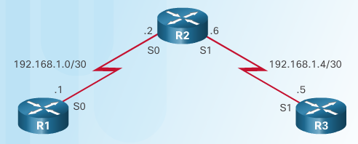
Troubleshooting Scenarios Using IP SLA
IP SLA ICMP Echo Configuration
Notes:
8.2 – Troubleshooting Scenarios
8.2.1 - Using IP SLA

Slide 14
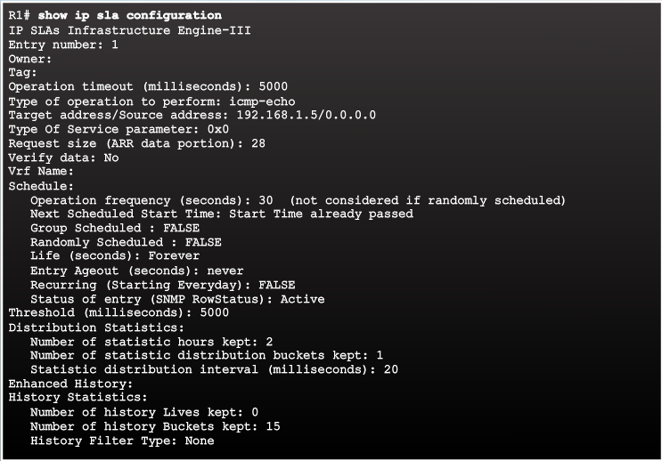
Troubleshooting Scenarios Using IP SLA
Verifying IP SLA Configuration
Notes:
8.2 – Troubleshooting Scenarios
8.2.1 - Using IP SLA

Slide 15
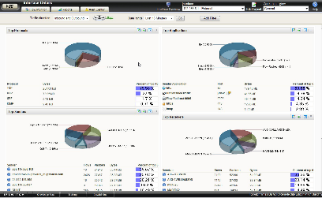
Troubleshooting Scenarios Troubleshooting Tools
Common software troubleshooting tools include:
Network Management System Tools include device-level monitoring, configuration, and fault-management tools. These tools can be used to investigate and correct network problems.
Knowledge Bases from device vendors, combined with Internet search engines like Google, are used by network administrators to access a vast pool of experience-based information.
Tools & Resources at http://www.cisco.com provide information on Cisco-related hardware and software.
Baselining Tools can draw network diagrams, help keep network software and hardware documentation up-to-date, and help to cost-effectively measure baseline network bandwidth use.
Protocol Analyzers are useful to investigate packet content while flowing through the network.
Notes:
8.2 – Troubleshooting Scenarios
8.2.2 - Troubleshooting Tools

Slide 16
Troubleshooting Scenarios Troubleshooting Tools
Common hardware troubleshooting tools include:
Digital Multimeters are test instruments that are used to directly measure electrical values of voltage, current, and resistance.
Cable Testers are specialized, handheld devices designed for testing the various types of data communication cabling. These devices send signals along the cable and wait for them to be reflected. The time between sending the signal and receiving it back is converted into a distance measurement.
Cable Analyzers are multifunctional handheld devices that are used to test and certify copper and fiber cables for different services and standards.
Portable Network Analyzers can be plugged in anywhere in the network and used for troubleshooting.
Network Analysis Module can capture and decode packets and track response times to pinpoint an application problem to a particular network or server.
Notes:
8.2 – Troubleshooting Scenarios
8.2.2 - Troubleshooting Tools

Slide 17
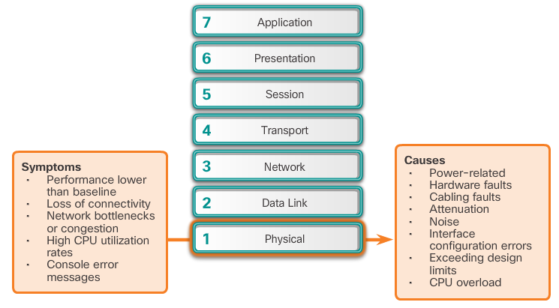
Troubleshooting Scenarios Symptoms and Causes of Network Troubleshooting
Physical Layer Troubleshooting
Notes:
8.2 – Troubleshooting Scenarios
8.2.3 - Symptoms and Causes of Network Troubleshooting

Slide 18
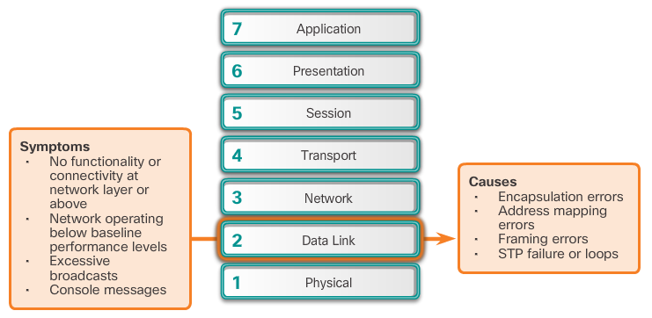
Troubleshooting Scenarios Symptoms and Causes of Network Troubleshooting
Data Link Layer Troubleshooting
Notes:
8.2 – Troubleshooting Scenarios
8.2.3 - Symptoms and Causes of Network Troubleshooting

Slide 19
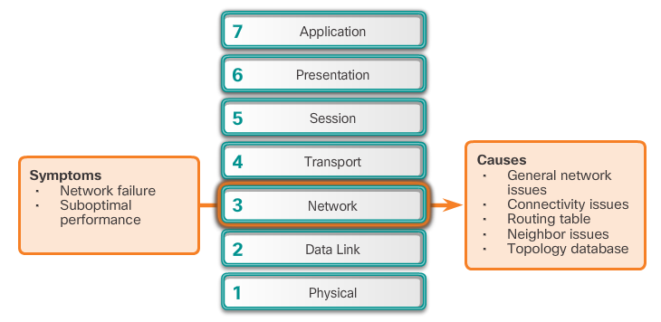
Troubleshooting Scenarios Symptoms and Causes of Network Troubleshooting
Network Layer Troubleshooting
Notes:
8.2 – Troubleshooting Scenarios
8.2.3 - Symptoms and Causes of Network Troubleshooting

Slide 20
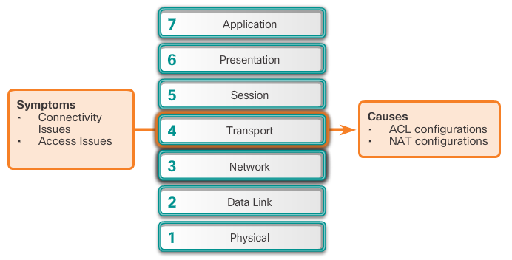
Troubleshooting Scenarios Symptoms and Causes of Network Troubleshooting
Transport Layer Troubleshooting
Notes:
8.2 – Troubleshooting Scenarios
8.2.3 - Symptoms and Causes of Network Troubleshooting

Slide 21
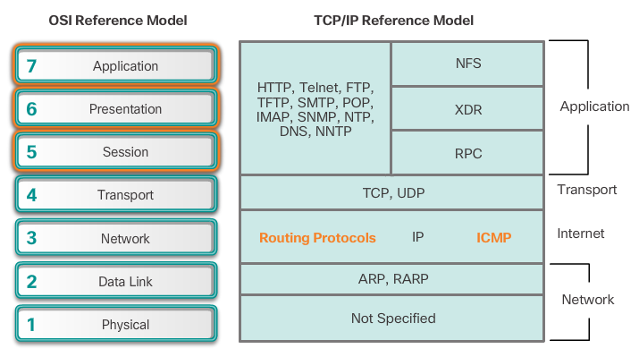
Troubleshooting Scenarios Symptoms and Causes of Network Troubleshooting
Application Layer Troubleshooting
Notes:
8.2 – Troubleshooting Scenarios
8.2.3 - Symptoms and Causes of Network Troubleshooting

Slide 22
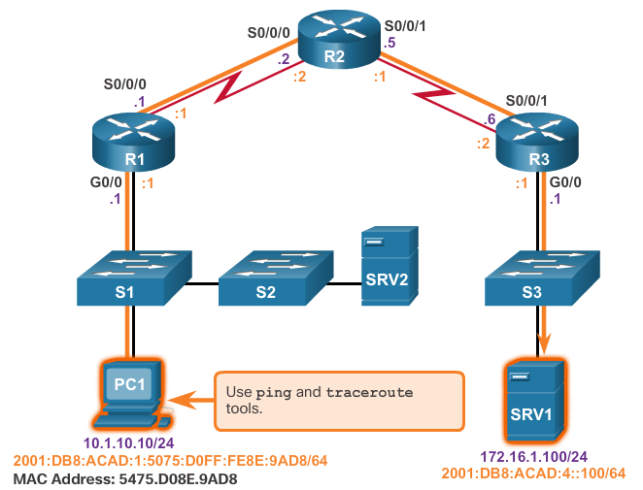
Troubleshooting Scenarios Troubleshooting IP Connectivity
Common bottom-up troubleshooting steps for end-to-end connectivity:
Step 1. Check physical connectivity
Step 2. Check for duplex mismatches.
Step 3. Check data link and network layer addressing.
Step 4. Verify that the default gateway is correct.
Step 5. Ensure that devices are determining the correct path from the source to the destination.
Step 6. Verify the transport layer is functioning properly.
Step 7. Verify that there are no ACLs blocking traffic.
Step 8. Ensure that DNS settings are correct.
Notes:
8.2 – Troubleshooting Scenarios
8.2.4 - Troubleshooting IP Connectivity

Slide 23
8.3 Chapter Summary
Notes:
Cisco Networking Academy Program
Connecting Networks
Chapter 8: Network Troubleshooting

Slide 24
Chapter Summary Summary
For network administrators to be able to monitor and troubleshoot a network, they must have a complete set of accurate and current network documentation, including configuration files, physical and logical topology diagrams, and a baseline performance level.
The three major stages to troubleshooting problems are gather symptoms, isolate the problem, then correct the problem.
The OSI model or the TCP/IP model can be applied to a network problem. A network administrator can use the bottom-up method, the top-down method, or the divide-and-conquer method.
Common software tools that can help with troubleshooting include network management system tools, knowledge bases, baselining tools, host-based protocol analyzers, and Cisco IOS EPC.
Hardware troubleshooting tools include a NAM, digital multimeters, cable testers, cable analyzers, and portable network analyzers. Cisco IOS log information can also be used to identify potential problems.
There are characteristic physical layer, data link layer, network layer, transport layer, and application layer symptoms and problems of which the network administrator should be aware. The administrator may need to pay particular attention to physical connectivity, default gateways, MAC address tables, NAT, and routing information.
Notes:
8.3 - Chapter Summary

