Slide 1
Instructor Materials Chapter 2: Configure a Network Operating System
CCNA Routing and Switching
Introduction to Networks v6.0
Notes:
Cisco Networking Academy Program
Introduction to Networks v6.0
Chapter 2: Configure a Network Operating System

Slide 2
Chapter 2 - Sections & Objectives
2.1 IOS Bootcamp
Explain the purpose of Cisco IOS.
Explain how to access a Cisco IOS device for configuration purposes.
Explain how to navigate Cisco IOS to configure network devices.
Describe the command structure of Cisco IOS software.
2.2 Basic Device Configuration
Configure hostnames on a Cisco IOS device using the CLI.
Use Cisco IOS commands to limit access to device configurations.
Use IOS commands to save the running configuration.
2.3 Address Schemes
Explain how devices communicate across network media.
Configure a host device with an IP address.
Verify connectivity between two end devices.
Notes:
2

Slide 3
2.1 IOS Bootcamp
Notes:
Cisco Networking Academy Program
Introduction to Networks v6.0
Chapter 2: Configure a Network Operating System

Slide 4
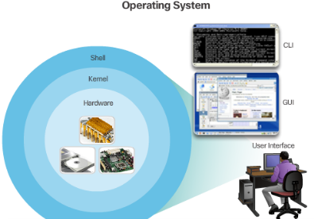
IOS Bootcamp Cisco IOS
Operating Systems
PC OS allows users to interact with the computer
User-computer interaction in PC OSs are often done via mouse, keyboard and monitor
Cisco IOS is also an Operating System
Cisco IOS allows users to interact with Cisco devices.
Cisco IOS enables a technician to:
Use a keyboard to run CLI-based network programs.
Use a keyboard to enter text and text-based commands.
View output on a monitor.
All Cisco networking devices come with a default IOS.
It is possible to upgrade the IOS version or feature set.
Notes:
2.1 – IOS Bootcamp
2.1.1 – Cisco IOS

Slide 5
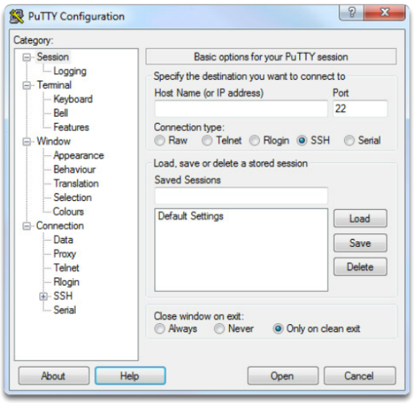
IOS Bootcamp Cisco IOS Access
Access Methods
Console
Auxiliar
Virtual Terminal (Telnet / SSH)
Terminal Emulation Programs
PuTTY
Tera Term
SecureCRT
Notes:
2.1 – IOS Bootcamp
2.1.3 – Cisco IOS Access

Slide 6
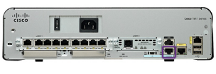
IOS Bootcamp Navigate the IOS
Cisco IOS Modes of Operation
Initial configuration must be done via console connection
Configuration is then done via various CLI command modes.
Primary Command Modes
User EXEC Mode
Privileged EXEC Mode
Configuration Command Modes
The Configure Terminal command enters the Global Configuration Mode.
Sub-configuration modes are accessible from the Privileged EXEC Mode.
Examples are: swtich(config-line)# and switch(config-if)#
Navigate Between IOS Modes
Navigation between modes is also done via commands.
The enable command enters the Privileged EXEC Mode.
The exit commands exits to the parent command mode.
Notes:
2.1 – IOS Bootcamp
2.1.3 – Navigate the IOS

Slide 7
IOS Bootcamp The Command Structure
Basic IOS Command Structure
The general syntax for a command is the command followed by any appropriate keywords and arguments.
Keyword - a specific parameter defined in the operating system
Argument - not predefined; a value or variable defined by the user
IOS Command Syntax
Provides the pattern or format that must be used when entering a command.
The Cisco IOS Command Reference is the ultimate source of information for a particular IOS command.
IOS Help Feature
The IOS has two forms of help available: Context-Sensitive Help and Command Syntax Check.
Hotkeys and Shortcuts
Commands and keywords can be shortened to the minimum number of characters that identify a unique selection.
Line editing keyboard shortcuts such as Ctrl-A are also supported.
Notes:
2.1 – IOS Bootcamp
2.1.3 –The Command Structure

Slide 8
2.2 Basic Device Configuration
Notes:
Cisco Networking Academy Program
Introduction to Networks v6.0
Chapter 2: Configure a Network Operating System

Slide 9
Basic Device Configuration Hostnames
Device Names
Hostnames allow devices to be identified by network administrators over a network or the Internet.
Very important and should also be displayed in the topology.
Configure Hostnames
IOS hostnames should:
Start with a letter
Contain no spaces
End with letter or digit
Use only letters, digits or dashes
Be less than 64 characters in length
Notes:
2.2 – Basic Device Configuration
2.2.1 –Hostnames

Slide 10
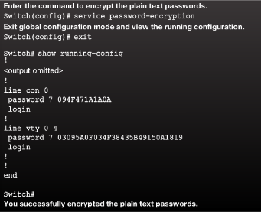
Basic Device Configuration Limit Access to Device Configurations
Secure Device Access
Secure privileged EXEC and user EXEC access with a password.
Secure virtual terminal lines with a password.
Configure Passwords
Use strong passwords.
Avoid re-using passwords
Encrypt Passwords
Cisco IOS displays passwords in plain text by default.
Passwords should be encrypted.
Banner Messages
Important part of the legal process in the event that someone is prosecuted for breaking into a device.
Wording that implies that a login is "welcome" or "invited" is not appropriate.
Often used for legal notification because it is displayed to all connected terminals.
Notes:
2.2 – Basic Device Configuration
2.2.2 –Limit Access to Device Configurations

Slide 11
Basic Device Configuration Save Configurations
Save the Running Configuration File
File stored in NVRAM that contains all of the commands that will be used upon startup or reboot
NVRAM does not lose its contents when the device is powered off.
Alter the Running Configuration
File stored in RAM that reflects the current configuration, modifying affects the operation of a Cisco device immediately.
RAM loses all of its content when the device is powered off or restarted.
Capture Configuration to a Text File
Configuration files can also be saved and archived to a text document.
The configuration can then be edited with any text editor and placed back in the device.
Notes:
2.2 – Basic Device Configuration
2.2.3 –Save Configurations

Slide 12
2.3 Address Schemes
Notes:
Cisco Networking Academy Program
Introduction to Networks v6.0
Chapter 2: Configure a Network Operating System

Slide 13
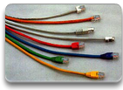
Address Schemes Ports and Addresses
IP Addresses
Each end device on a network must be configured with an IP address.
Enable devices to establish end-to-end communication on the Internet.
The structure of an IPv4 address is called dotted decimal notation and is represented by four decimal numbers between 0 and 255.
IPv6 is the most recent version of IP and the replacement for the more common IPv4.
Interface and Ports
Network communications depend on interfaces and the cables that connect them.
Different types of network media have different features and benefits.
Ethernet is the most common local area network (LAN) technology.
SVI provides a means to remotely manage a switch over a network.
Notes:
2.3 – Address Schemes
2.3.1 – Ports and Addresses

Slide 14
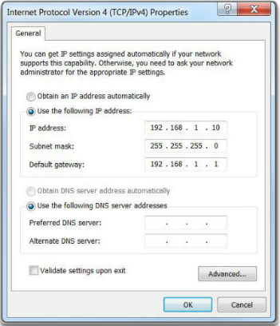
Address Schemes Configure IP Addressing
Manual IP Address Configuration for End Devices
To manually configure an IPv4 address on a Windows host, open the Control Panel > Network Sharing Center > Change adapter settings and choose the adapter.
Next right-click and select Properties to display the Local Area Connection Properties shown in Figure 1.
Automatic IP Address Configuration for End Devices
DHCP enables automatic IPv4 address configuration for every end device that has DHCP enabled. No extra configuration is needed.
Switch Virtual Interface Configuration
To configure an SVI on a switch, use the interface vlan 1 global configuration command. Vlan 1 is not an actual physical interface but a virtual one.
Notes:
2.3 – Address Schemes
2.3.2 – Configure IP Addressing

Slide 15
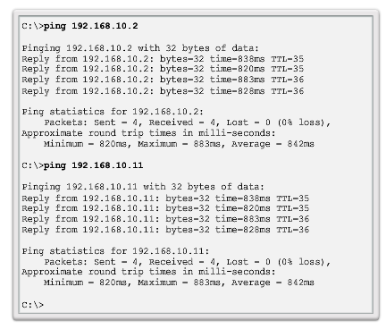
Address Schemes Verifying Connectivity
Interface Addressing Verification
Cisco IOS supports commands to allow IP configuration verification.
End-To-End Connectivity Test
The ping command can be used to test connectivity to another device on the network or a website on the Internet.
Notes:
2.3 – Address Schemes
2.3.3 – Verifying Connectivity

Slide 16
2.4 Chapter Summary
Notes:
Cisco Networking Academy Program
Introduction to Networks v6.0
Chapter 2: Configure a Network Operating System

Slide 17
Chapter Summary Summary
Explain the features and functions of Cisco IOS Software.
Configure initial settings on a network device using the Cisco IOS software.
Given an IP addressing scheme, configure IP address parameters on end devices to provide end-to-end connectivity in a small to medium-sized business network.
Notes:
2.4.1 - Summary

Slide 18
Section 2.1 New Terms and Commands
kernel
shell
Command-line interface (CLI)
Graphical user interface (GUI)
Cisco IOS
Firmware
Console
Out-of-band
SSH
Telnet
Auxiliary port (AUX)
PuTTY
Tera Term
SecureCRT
OS X Terminal
Cisco IOS modes
User EXEC mode
Privileged EXEC mode
Global Configuration Mode
Line configuration mode
Interface configuration mode
enable command
disable command
exit command
end command
Key combination – Ctrl+Z
Context-Sensitive Help
Command Syntax Check
CLI Hot Keys and Shortcuts
Hostnames
Notes:
New Terms and Commands

Slide 19
Section 2.2 New Terms and Commands
hostname name
Strong passwords
enable secret class
line console 0
password cisco
login
line vty 0 15
service password-encryption
banner motd # the message of the day #
Startup configuration
Random Access Memory (NVRAM)
Running configuration
Random Access Memory (RAM)
show running-config
copy running-config startup-config
reload
Notes:
New Terms and Commands

Slide 20
Section 2.3 New Terms and Commands
IPv4 address
Subnet mask
Default gateway
Physical ports
Virtual interface
Copper
Fiber Optics
Wireless
Ethernet
Local Area Network (LAN)
Layer 2 switch
Layer 3 addresses
Switch virtual interface (SVI)
Dynamic Host Configuration (DHCP)
Domain Name System (DNS)
ipconfig command prompt
interface vlan 1
Notes:
New Terms and Commands

